Slide 1
Digital Portfolio
STUDENT NAME: DEEPIKA TS
REGISTER NO AND NMID:
36CCDD638BB2E6CBBC0429544C35FDA1/212400990
DEPARTMENT: COMPUTER APPLICATION
COLLEGE: UNIVERSITY OF MADRAS

Slide 2
PROJECT TITLE
DIGITAL PORTFOLIO USING FRONT END WEB DEVELOPMENT

Slide 3


AGENDA
Problem Statement
Project Overview
End Users
Tools and Technologies
Portfolio design and Layout
Features and Functionality
Results and Screenshots
Conclusion
Github Link
3/21/2024 Annual Review

Slide 4

PROBLEM STATEMENT
In today’s digital era, traditional paper-based portfolios are often difficult to maintain, update, and share with potential employers, educators, or clients. They lack interactivity, accessibility, and personalization, making it challenging to showcase skills, achievements, and creativity effectively. Many individuals and students struggle to present their work in an organized, engaging, and professional manner that highlights their unique strengths. Therefore, there is a need for a digital portfolio system that allows users to create, customize, and present their personal, academic, or professional achievements in a visually appealing and easily accessible online format.

Slide 5

PROJECT OVERVIEW
In today’s digital era, traditional paper-based portfolios are often difficult to maintain, update, and share with potential employers, educators, or clients. They lack interactivity, accessibility, and personalization, making it challenging to showcase skills, achievements, and creativity effectively. Many individuals and students struggle to present their work in an organized, engaging, and professional manner that highlights their unique strengths. Therefore, there is a need for a digital portfolio system that allows users to create, customize, and present their personal, academic, or professional achievements in a visually appealing and easily accessible online format.

Slide 6

WHO ARE THE END USERS?
The end users of a digital portfolio primarily include students, job seekers, and professionals who wish to present their academic achievements, skills, and work experiences in an organized and interactive format. It also caters to creative professionals such as designers, writers, and artists who need a platform to showcase their projects and creativity. In addition, educators and researchers can use digital portfolios to share their publications, teaching methods, and contributions to their field. On the other side, employers, recruiters, and clients act as secondary users who review these portfolios to evaluate the individual’s potential, creativity, and suitability for opportunities. Thus, a digital portfolio serves both creators who design and manage their profiles, and evaluators who access and analyze them for decision-making.

Slide 7

TOOLS AND TECHNIQUES
The development of a digital portfolio involves the use of various tools and techniques to ensure efficiency, usability, and professional presentation. Front-end technologies such as HTML, CSS, and JavaScript are used to design and structure the user interface, while frameworks like React or Bootstrap can enhance responsiveness and interactivity. For storing user data, databases such as MySQL or Firebase are employed, supported by server-side technologies like PHP, Node.js, or Python (Django/Flask). Designing tools such as Canva, Figma, or Adobe XD may be used for creating appealing layouts and templates. Version control systems like Git and GitHub help in collaborative development and tracking updates. Techniques such as responsive design, user authentication, data encryption, and cloud deployment ensure that the portfolio is secure, accessible, and adaptable across multiple devices. Together, these tools and techniques contribute to building a dynamic and professional digital portfolio.

Slide 8
POTFOLIO DESIGN AND LAYOUT
The design and layout of a digital portfolio should be simple, professional, and easy to navigate. A typical portfolio includes sections such as Home, About Me, Skills, Projects, Achievements, Resume, and Contact. Consistent use of colors, fonts, and spacing ensures clarity and a professional look, while images and multimedia make the portfolio engaging. The layout should follow responsive design so it works well on desktops, tablets, and mobile devices. Overall, the design must highlight the individual’s strengths and allow viewers to quickly access important information.
8

Slide 9
FEATURES AND FUNCTIONALITY
A digital portfolio comes with various features and functions that make it more effective than traditional formats. Key features include sections such as About Me, Skills, Projects, Certifications, Resume, and Contact Information, along with options to add images, videos, and documents for better presentation. It supports customization, allowing users to design layouts, choose themes, and personalize content to match their identity. Important functions include easy navigation, responsive design, user authentication, and data storage, which ensure accessibility and security. Some portfolios also provide sharing options, enabling users to generate links or QR codes for employers and clients. Together, these features and functions help individuals showcase their achievements in an interactive, organized, and professional manner.

Slide 10
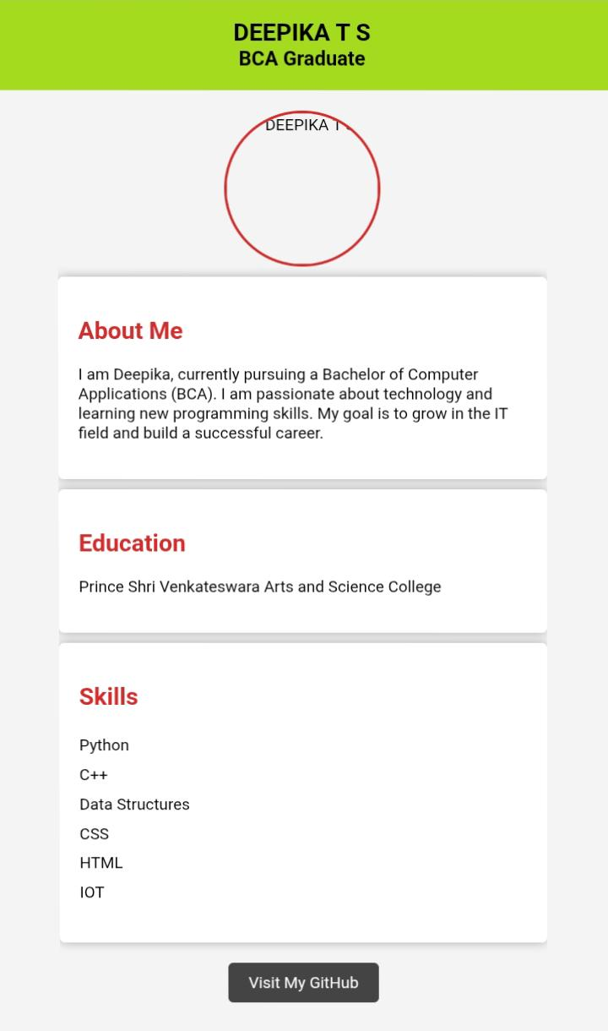

RESULTS AND SCREENSHOTS
The result of the digital portfolio is an interactive and professional platform that showcases an individual’s skills, projects, and achievements in an organized and accessible way. It helps users present themselves effectively to employers, recruiters, or clients.
3/21/2024 Annual Review
10

Slide 11
CONCLUSION
In conclusion, a digital portfolio provides a modern, efficient, and creative way to present personal and professional achievements, making it easier for users to stand out and connect with opportunities.
11

Slide 12
Github link
https://github.com/Deepikats-debug/T.S.Deepika-portfolio.git

